Slide 1

Acceleration Data

Slide 2

Data Types
Fitbit Data
Wavelet Data
Awake
Sleep
X Axis
Y Axis
Z Axis
This Photo by Unknown Author is licensed under CC BY-SA

Slide 3
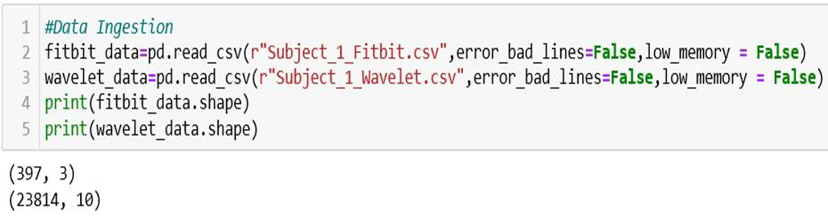
Data Ingestion
In Fitbit Data
Rows #397 & Columns # 3
In Wavelet Data
Rows # 23814 & Columns # 8

Slide 4
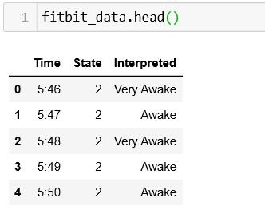
Fitbit Data

Slide 5
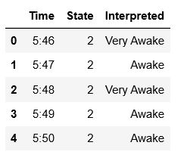
Task #1
In Fitbit Data change Very Awake to Awake
Hints: Using python Function to replace

Slide 6
Source Code

Slide 7
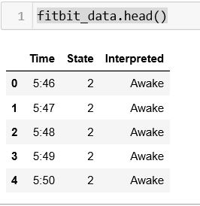
This is the Outpu:

Slide 8
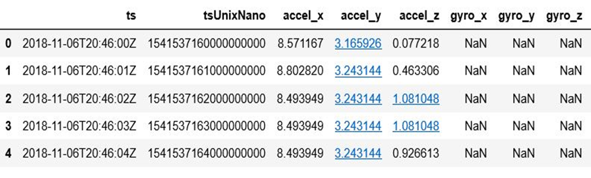
Wavelet Data

Slide 9

Task #2
Change Time Nano Second to second & Mints
Hints : https://www.unixtimestamp.com/index.php
Hints : using python datetime function

Slide 10
Convert Time Nanosecond to Seconds
tuUnixNano/1000000000
H:M
H:M:S

Slide 11
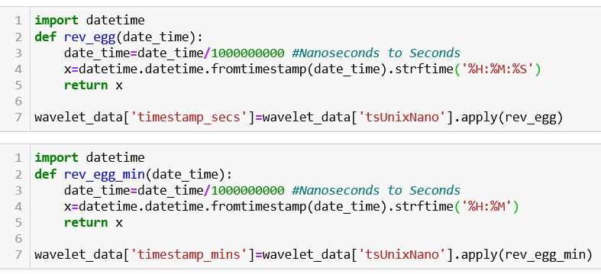
Source Code

Slide 12
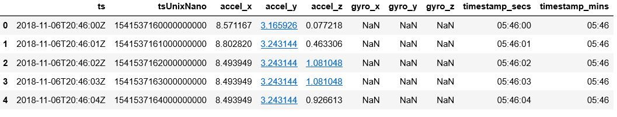
This is the Output:

Slide 13
Task #3
In Fitbit Data Find Start and End Time
Hints : Using python

Slide 14
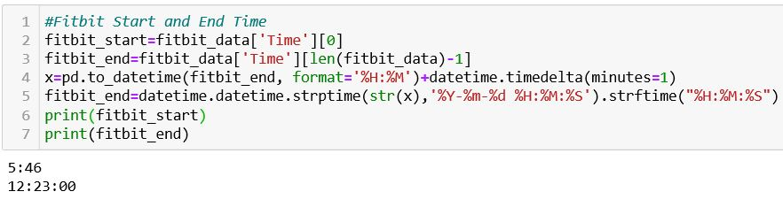
Source Code

Slide 15
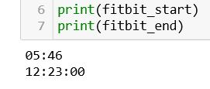
This is the Output:

Slide 16
Task #4
In Wavelet Data
Using abs function change any negative value to positive value
Find Absolute value of( accel_x , accel_y , accel_z )
Hints : Using Python abs function

Slide 17
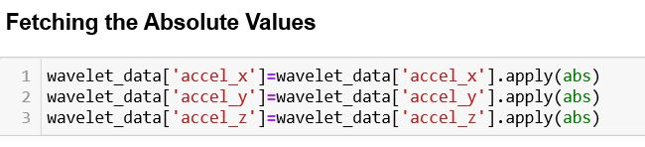
Source Code

Slide 18
Find Absolute Value
X Axis(2,-3)
abs
X Axis(2,3)
Y Axis(4,-5)
Y Axis(4,5)
Z Axis(-7,8)
Z Axis(7,8)

Slide 19
Task # 5
In Wavelet Data
Collapsing the Rows Of Raw Data to a 60 Seconds Epochs
Every 60 second count as 1 Mints
Hints : Using Python sum & groupby Function

Slide 20
X(1,2,3…60)
X(1)
(2)
Sum
y(1,2,3…60)
Y(1)
(2)
z(1,2,3…60)
Z(1)
(2)

Slide 21
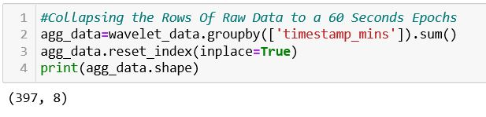
Source Code

Slide 22
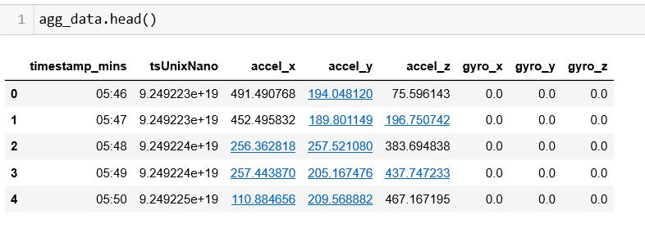
This is the Output:

Slide 23
Task #6
In Wavelet Data
Find the Resultant Vector of ( accel_x , accel_y , accel_z )
Hints : Create User define function in Python

Slide 24
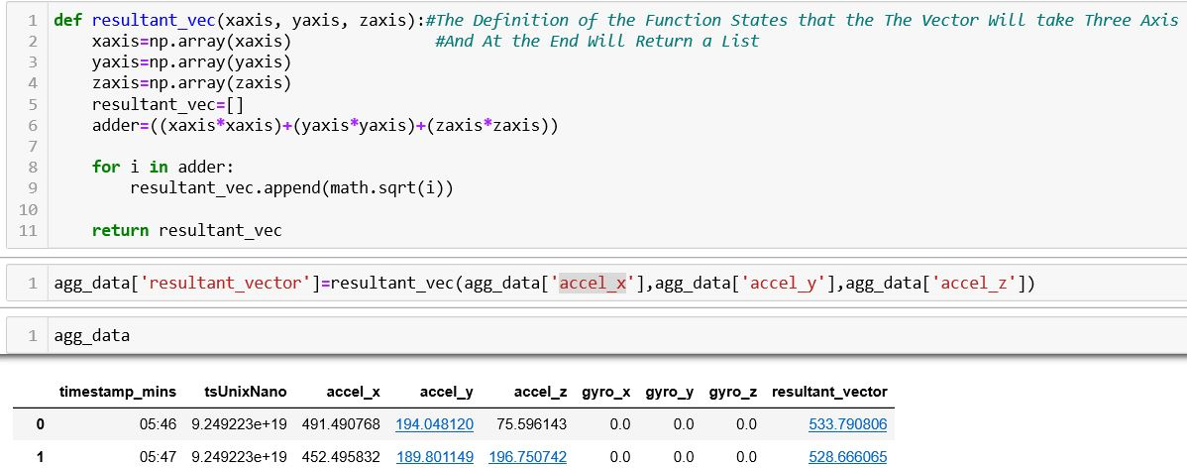
Source Code

Slide 25
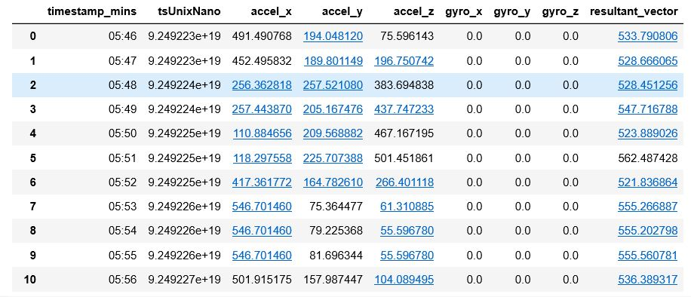
This is the Output:

Slide 26
Task #7
Calculate the Mean of Resultant Vector
Hints : Using Python Mean function

Slide 27
Find Resulting Vector and Mean
Result Vector
X Axis
Mean
Y Axis
Z Axis
OutPut

Slide 28
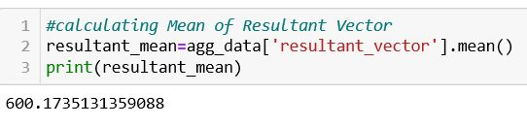
Source Code

Slide 29
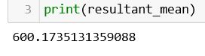
This is the Output:

Slide 30
Task #8
Identifying The Vibration Mechanism
Least Vibration Threshold ( accel_x , accel_y , accel_z )
Hints : Create User define function

Slide 31
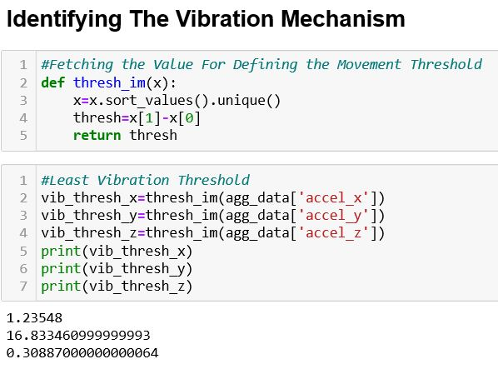
Source Code

Slide 32
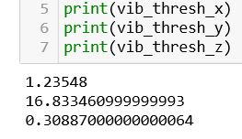
This is the Output:

Slide 33
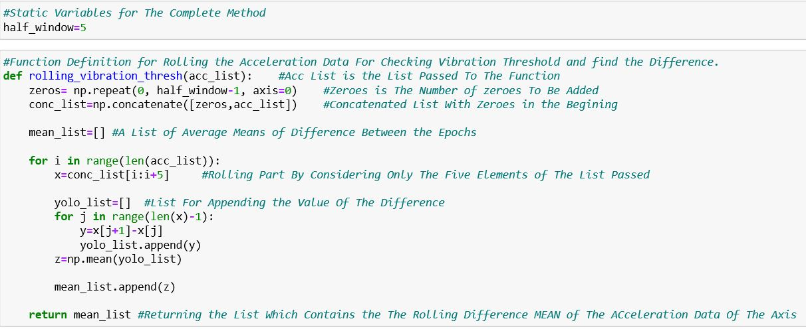
Rolling the Accerelation Data
0
0
0
0
x1
x1
Y1=x2-x1
y1
x2
x2
Y2=x3-x2
y2
x3
x3
z5=mean(y1,y2,y3,y4)
z5
x4
Y3=x4-x3
y3
x4
x5
Y4=x5-x4
y4
x5
x6
x7
xn

Slide 34
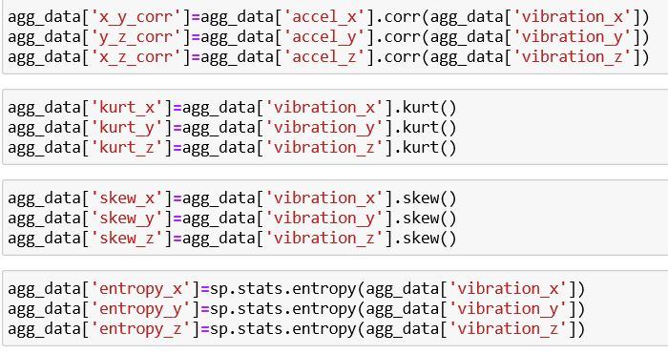
Feature Engineering

Slide 35
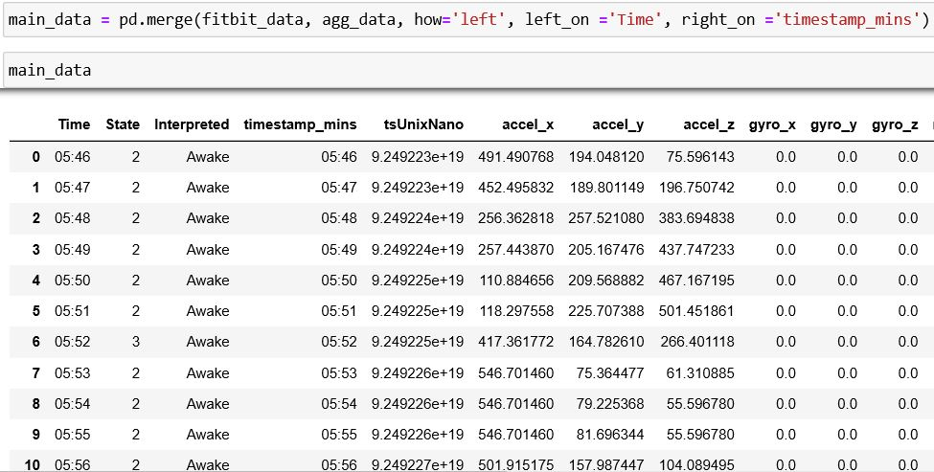
Join Fitbit and Aggregate Data
Fitbit Data
Join
Aggregate Data
New Data

Slide 36
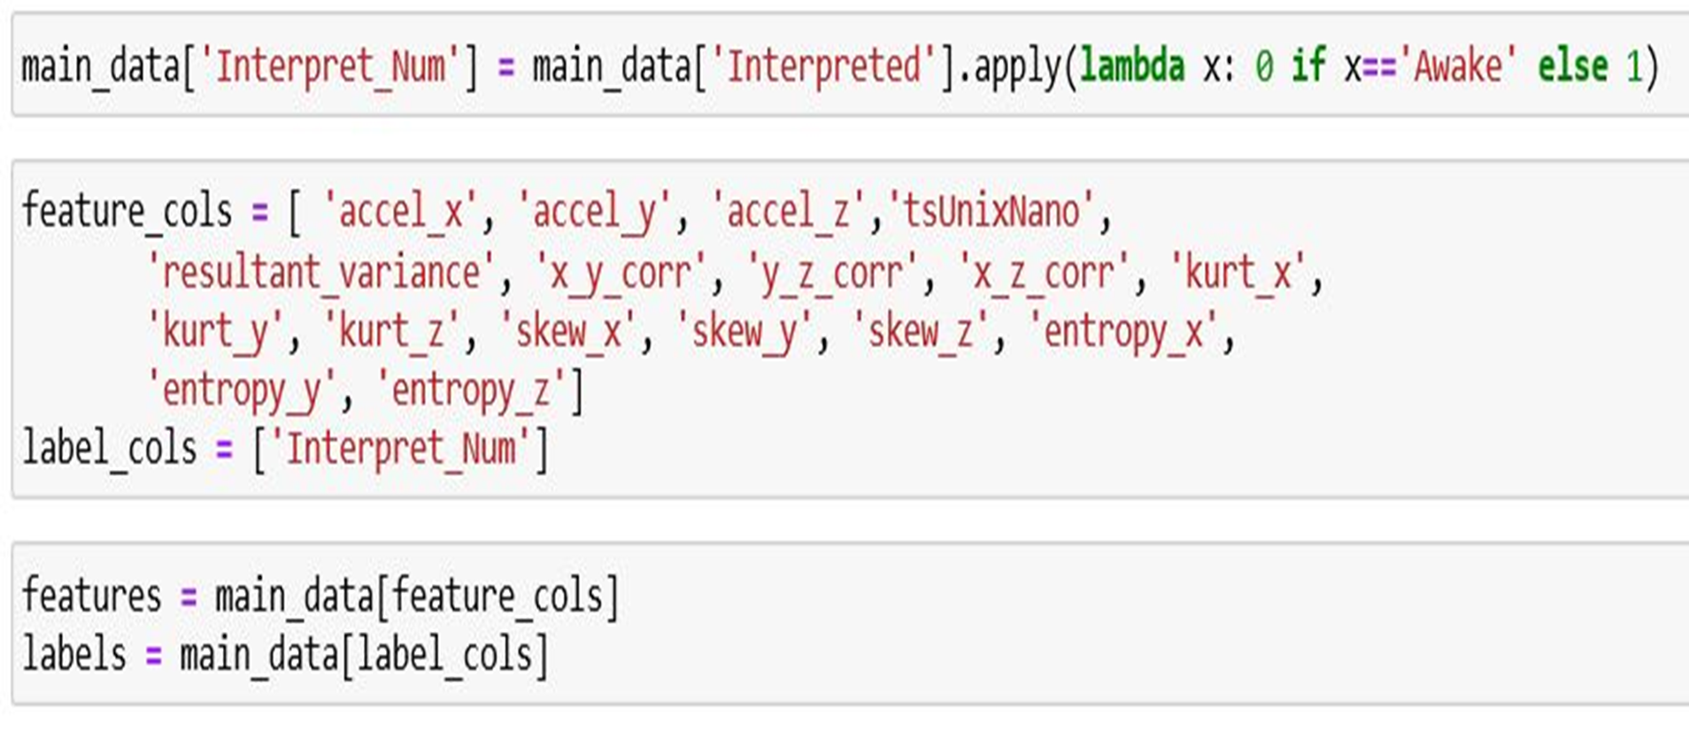
Features and label columns

Slide 37
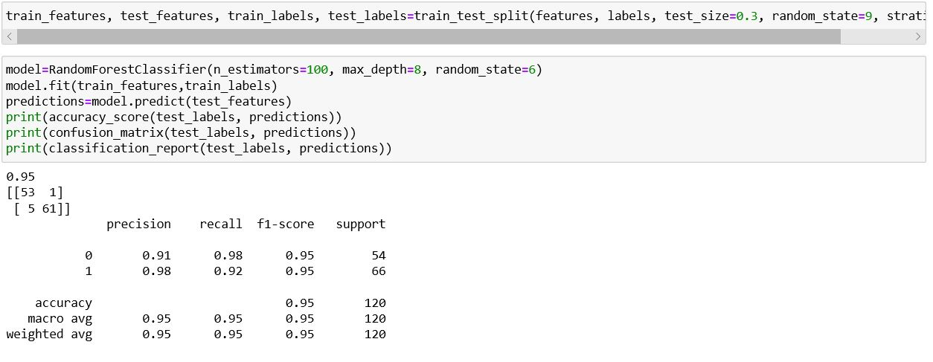
Train the Model And Accuracy

Slide 38
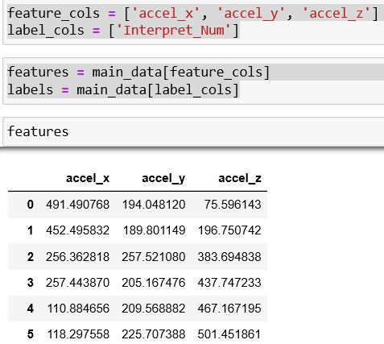
If We Select three Features columns

Slide 39
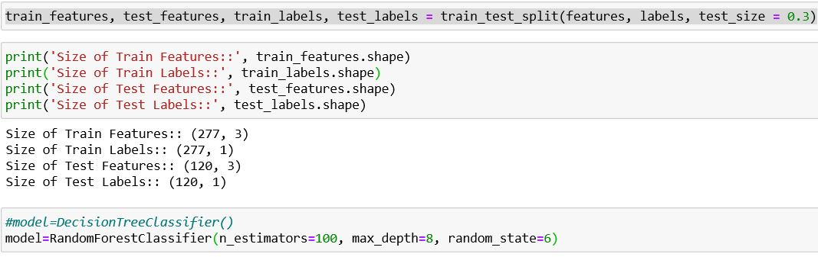
Train the Model

Slide 40
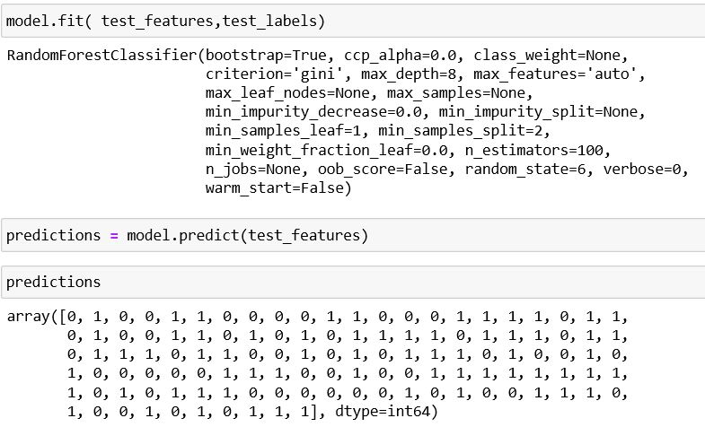
Prediction

Slide 41
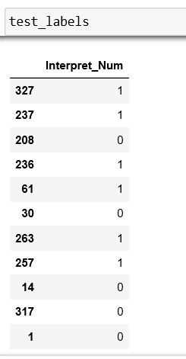
Test Label

Slide 42
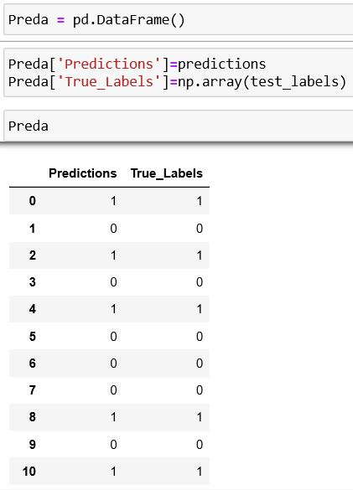
Prediction and True Labels

Slide 43
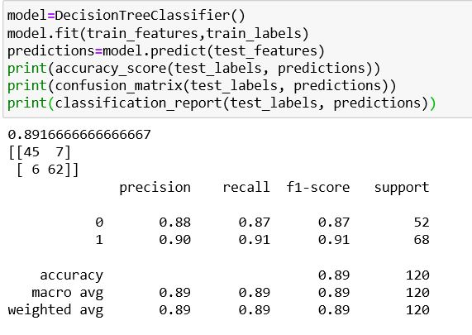
Decision Tree Classifier

